Slide 1





CODE FOR GOOD
[PROJECT NAME]
[ONE-LINE VALUE PROPOSITION: Describe what the solution achieves and who benefits]
TEAM IDENTIFICATION
TEAM MEMBERS
JUDGING PANEL
Team [NUMBER]
[MEMBER 1, MEMBER 2, MEMBER 3, MEMBER 4]
KLU Alumni @ JPMorgan Chase

Slide 2






The Problem
[PAIN POINT 1]
[Describe the primary operational inefficiency or bottleneck.]
"[CORE PROBLEM: State the specific operational, societal, or technical bottleneck in 1–2 clear sentences.]"
[PAIN POINT 2]
Why does this matter? [REAL-WORLD IMPACT: Explain the critical consequence if this issue remains unaddressed.]
[Describe data fragmentation, latency, or communication breakdown.]
[PAIN POINT 3]
[Describe scalability constraint, manual overhead, or accessibility barrier.]
TARGET STAKEHOLDERS
Primary Users / Beneficiaries: [PRIMARY USERS] Secondary Stakeholders: [SECONDARY STAKEHOLDERS]
KEY BASELINE METRIC
[STAT %]
[DESCRIPTION OF CURRENT INEFFICIENCY / METRIC]
[PROJECT NAME] · Code for Good 2026
Slide 02 / 08

Slide 3







Our Solution
SOLUTION STATEMENT
"We built , a that helps to by ."
1. User Access
2. Our Platform
3. Processing / Optional AI
4. Result / Action
[User accesses portal / inputs data / submits request]
[System routes, validates, and orchestrates data workflows]
[Automated logic, business rules, or optional intelligence engine]
[Verified action, real-time feedback, or dashboard update]
[PROJECT NAME] · Code for Good 2026
Slide 03 / 08

Slide 4











Key Features
FEATURE 01
FEATURE 02
FEATURE 03
[FEATURE 1]
[FEATURE 2]
[FEATURE 3]
[One-line concise technical description of the feature and how it resolves a pain point.]
[One-line concise technical description of the feature and how it resolves a pain point.]
[One-line concise technical description of the feature and how it resolves a pain point.]
FEATURE 04
FEATURE 05
FEATURE 06
[FEATURE 4]
[FEATURE 5]
[FEATURE 6]
[One-line concise technical description of the feature and how it resolves a pain point.]
[One-line concise technical description of the feature and how it resolves a pain point.]
[One-line concise technical description of the feature and how it resolves a pain point.]
[PROJECT NAME] · Code for Good 2026
Slide 04 / 08

Slide 5





System Architecture
Authentication
[Authentication Technology / RBAC / Security Protocol]
REST / HTTPS / WebSockets
Optional AI / Intelligence
[Optional AI/ML Model / Service / Rule Engine (Remove if unused)]
External APIs
[External API / Notification / Third-Party Integrations]
Cloud / Deployment
API Gateway / JSON Payloads
[Hosting Platform / Containerization / CI-CD Pipeline]
Database Drivers / Queries
[PROJECT NAME] · Code for Good 2026
Slide 05 / 08

Slide 6




How It Works
1. User Input
2. Validation
3. Processing
4. Optional AI
5. Result / Action
User initiates request or inputs data through the application interface.
System validates payload schema, checks permissions, and sanitizes input.
Core backend logic processes business rules, workflows, and state transitions.
Optional intelligence layer executes analysis, matching, or automated scoring.
Application delivers final output, triggers notifications, and persists state.
[PROJECT NAME] · Code for Good 2026
Slide 06 / 08

Slide 7











Product Demo
[SCREENSHOT 1 — USER ENTRY]
[SCREENSHOT 2 — CORE WORKFLOW]
[SCREENSHOT 3 — FINAL RESULT]
Recommended: 16:9 UI Capture
Recommended: 16:9 UI Capture
Recommended: 16:9 UI Capture
[STEP 1]
[STEP 2]
[STEP 3]
[User Onboarding / Input]
[Core Processing / Workflow]
[Results & Action Dashboard]
[Brief caption explaining what the user does on this specific screen.]
[Brief caption explaining the processing or management view shown.]
[Brief caption highlighting the completed action and delivered impact.]
[PROJECT NAME] · Code for Good 2026
Slide 07 / 08

Slide 8
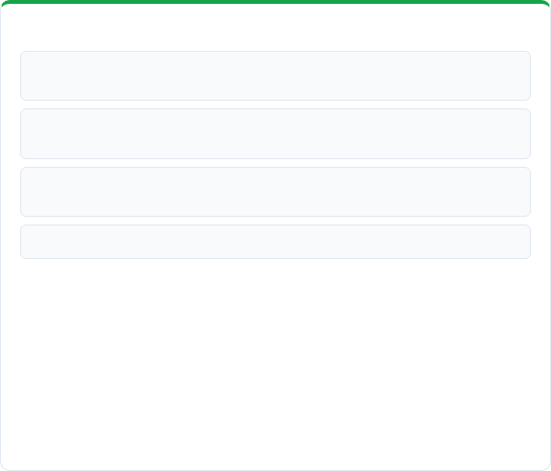
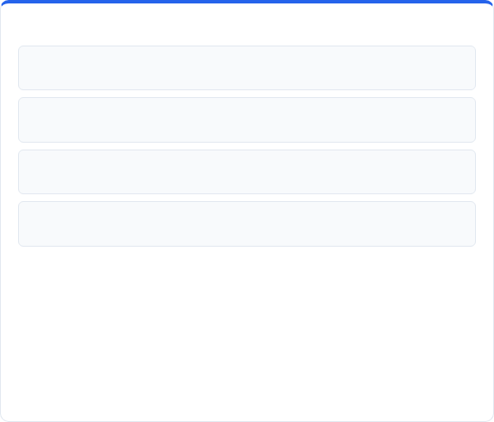
Impact & Future Scope
Measurable Impact
Future Scope
[MEASURABLE IMPACT 1]: [Quantifiable operational efficiency or reduction in turnaround time.]
[FUTURE IMPROVEMENT 1]: [Near-term architectural enhancement or offline capability.]
[MEASURABLE IMPACT 2]: [Resource optimization, accuracy enhancement, or cost reduction.]
[FUTURE IMPROVEMENT 2]: [Accessibility features, multilingual localization, or voice integration.]
[MEASURABLE IMPACT 3]: [User reach, scale of beneficiaries served, or reduced friction.]
[FUTURE IMPROVEMENT 3]: [Advanced analytics, automated scoring, or predictive modeling.]
[MEASURABLE IMPACT 4]: [End-to-end transparency, auditability, and data reliability.]
[FUTURE IMPROVEMENT 4]: [Public API integrations, third-party ecosystem connectors, or enterprise scalability.]
Thank You! — [PROJECT NAME]
[PROJECT NAME] · Code for Good 2026
Slide 08 / 08

